Slide 1
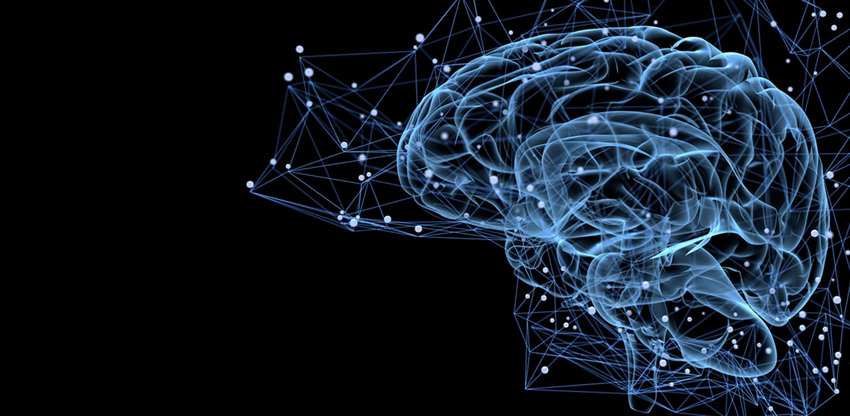
Machine Learning in Simplified Way
By:
Dr. Amit Ganatra

Slide 2
What is Learning?
“Learning denotes changes in a system that ... enable a system to do the same task … more efficiently the next time.” - Herbert Simon
“Learning is constructing or modifying representations of what is being experienced.” - Ryszard Michalski
“Learning is making useful changes in our minds.” - Marvin Minsky
“Machine learning refers to a system capable of the autonomous acquisition and integration of knowledge.”

Slide 3
Learning…
Most perception (Input Processing) in the brain may be due to one learning algorithm.
Most human intelligence is due to one learning algorithm
Build learning algorithms that mimic the brain
Learning from tagged data (Supervised Learning)
Learning from untagged data (Unsupervised Learning)
Learning from Environment (Reinforcement Learning)
Bigger Data – More training is better
Machine Learning and Deep Learning

Slide 4
Dimensions of Learning Systems
Type of feedback
Supervised (labeled examples)
Unsupervised (unlabeled examples)
Semi supervised (labeled examples and unlabeled examples)
Reinforcement (based on reward and panelty)

Slide 5
What is AI?
Intelligence: “Ability to learn, Understand and Think”

Slide 6
Intelligence v/s Artificial Intelligence
Intelligence is a property/ability attributed to people, such as to know, to think, to talk, to learn, to understand.
Intelligence = Knowledge + ability to perceive, feel, comprehend, process, communicate, judge, learn.
Artificial Intelligence is an interdisciplinary field aiming at developing techniques and tools for solving problems that people at good at.

Slide 7
AI involves many disciplines
Philosophy
Mathematics
Psychology
Computer Engineering
Linguistics
Plus the problem domain

Slide 8
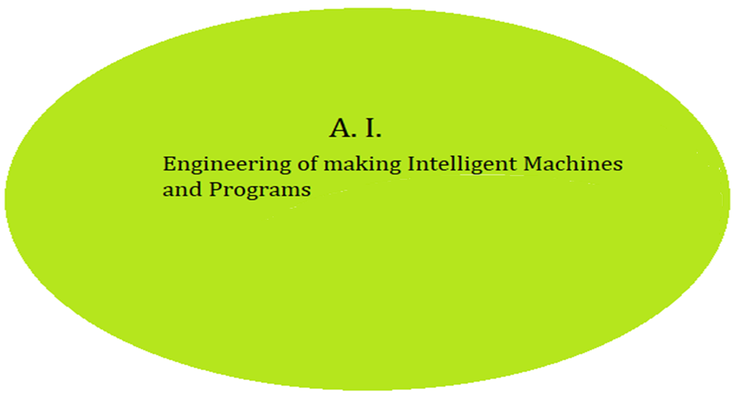
Artificial Intelligence

Slide 9
What is Artificial Intelligence ?
THOUGHT
Systems that think like humans
Systems that think rationally
Systems that act like humans
Systems that act rationally
BEHAVIOUR
HUMAN
RATIONAL

Slide 10
Artificial
Produced by human art or effort, rather than originating naturally
“Intelligence is the ability to acquire knowledge and use it" -
So AI was defined as:
AI is the study of ideas that enable computers to be intelligent
AI is the part of computer science concerned with design of computer systems that exhibit human intelligence

Slide 11
AI Terms
Artificial Intelligence: The capability of a machine to imitate intelligent human behavior
Artificial Neural Network: A network of neurons with connections of varying strength
Fuzzy Logic: A superset of Boolean logic which includes truth values between true and false
Knowledge Base: A collection of knowledge expressed using some formal knowledge representation language
AI-complete: Describes a problem which presupposes a solution to the “strong AI problem”

Slide 12
The main topics in AI
Artificial intelligence can be considered under a number of headings:
Search (includes Game Playing).
Representing Knowledge and Reasoning with it.
Planning.
Machine Learning.
Natural language processing.
Expert Systems.
Interacting with the Environment (e.g. Vision, Speech recognition, Robotics)

Slide 13
Areas of AI
Knowledge Representation
Search
Logic
Machine Learning
Planning
Expert Systems
NLP
Vision
Robotics

Slide 14
AI Paradigms
Expert systems
Neural networks
Genetic algorithms
Fuzzy logic

Slide 15
Some Advantages of Artificial Intelligence
More powerful and more useful computers
New and improved interfaces
Solving new problems
Better handling of information
Relieves information overload
Conversion of information into knowledge

Slide 16
The Disadvantages
Increased costs
Difficulty with software development - slow and expensive
Few experienced programmers
Few practical products have reached the market as yet.

Slide 17
Typical Applications of AI
Game playing and Microworlds
Computer vision
Natural language processing
Diagnosis systems
Control
Optimisation
Robotics

Slide 18
Sectors/Areas/Domains
Healthcare
Retail
Telecommunication
Social Media
Education
Finance
Agriculture
Oil and Gas
Military and Armed Forces

Slide 19
Application of AI
Chatbots
Artificial Intelligence in e-Commerce
AI to Improve Workplace Communication
Human Resource Management
Intelligent Cybersecurity
AI in Logistics and Supply Chain

Slide 20
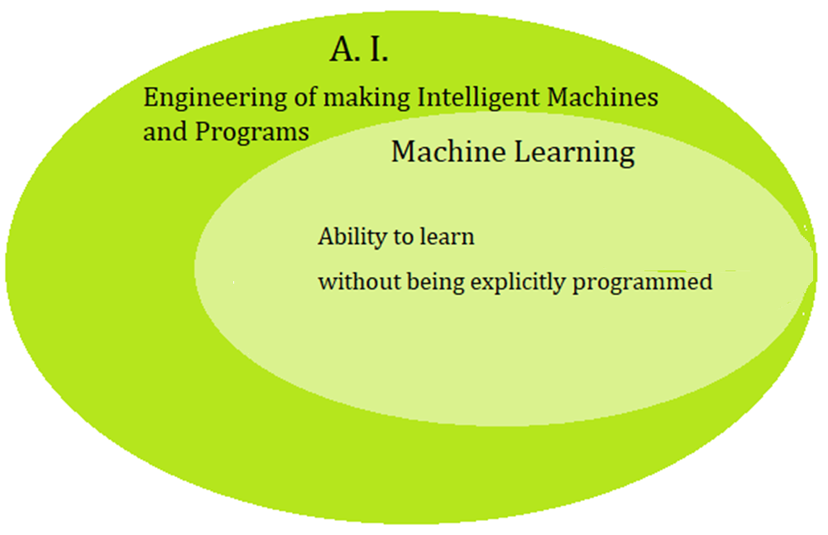
Machine Learning

Slide 21
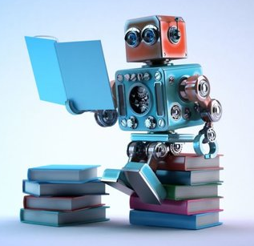
Machine Learning – A definition
“A computer program is said to learn from experience E with respect to some class of tasks T and performance measure P if its performance at tasks in T, as measured by P, improves with experience E ” - Tom Mitchell

Slide 22
What Is Machine Learning?
Enabling machines to process data in such a way that it can be used to make future decisions
ML has been studied for many years
ML has many applications in a variety of fields

Slide 23
AI-ML-DL
AI- Any program that passes Turing Test, it means any machine makes you believe its human i.e. AI (Mimic Human (Human Brain) and Pass the Turing Test
ML- Learning with/from Experience
DL- Self Learning with/from more(huge amount of) data
In ML/DL/AI, Lots of data need to be parsed

Slide 24
AI-ML-DL
ML (NNs) to simulate human like decision making
ML- A type or subset of AI- It provides computers with the ability to learn without explicitly programming it.

Slide 25
Steps for Machine Learning:
Collecting data
Exploring and preparing the data
Selecting the Machine Leaning approach
Training the model on the data
Evaluating model performance
Improving model performance
After these steps have been completed, if the model appears to be performing satisfactorily, it can be deployed for its intended task

Slide 26
Why Machine Learning?
No human experts
Industrial/Manufacturing control
Mass spectrometer analysis, drug design, astronomic discovery
Black-box human expertise
Face/Handwriting/Speech Recognition
Driving a car, Flying a plane
Rapidly changing phenomena
Credit scoring, Financial Modeling
Diagnosis, Fraud Detection
Need for customization/personalization
Personalized news reader
Movie/Book Recommendation

Slide 27
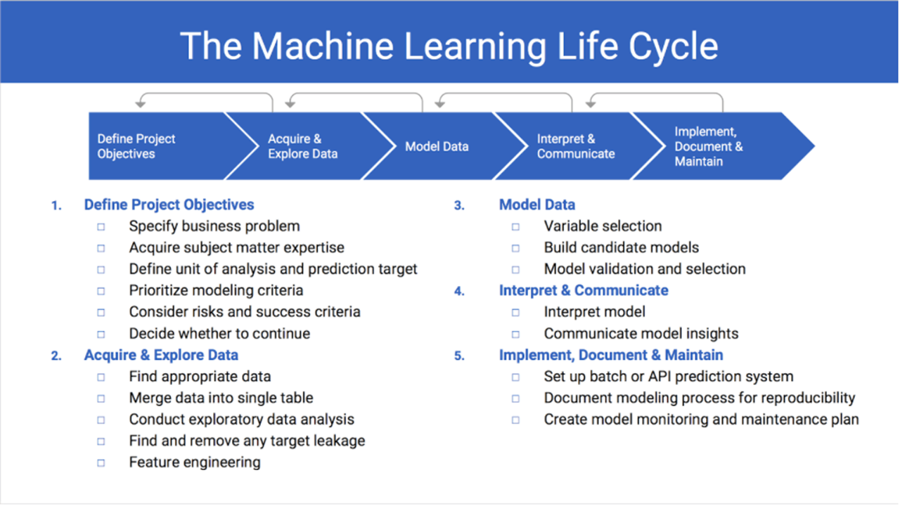
Image Source: https://www.datarobot.com/wiki/machine-learning-life-cycle/

Slide 28
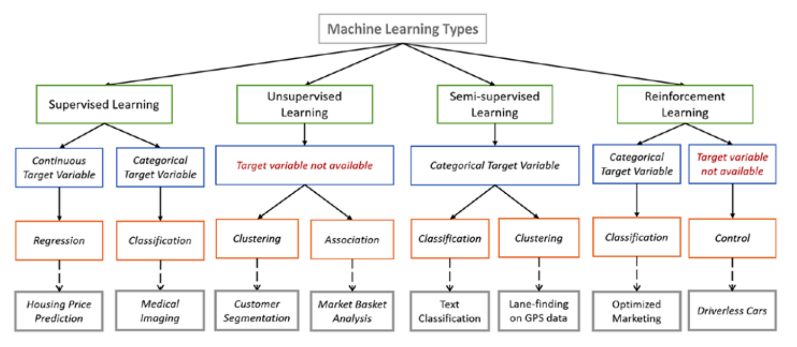
Image Source: https://towardsdatascience.com/types-of-machine-learning-algorithms-you-should-know-953a08248861

Slide 29
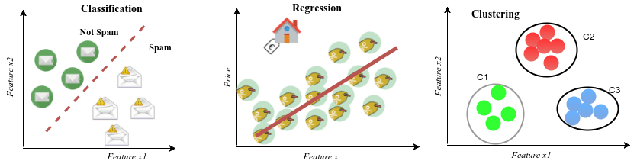
Examples of real-life problems in the context of supervised and unsupervised learning tasks: Spam filtering as a classification task and House price estimation as a regression task are part of supervised learning; Clustering is part of unsupervised learning in which customers are grouped into three different categories based on their purchasing behavior.
Image Source: DEEP GENERATIVE MODELS FOR SYNTHETIC RETINAL IMAGE GENERATION, Lappeenranta University of Technology, July 2017

Slide 30


Learning Methods
Supervised learning ( )
Classification (discrete labels), Regression (real values)
Prediction
Unsupervised learning ( )
Clustering
Finding association (in features)
Dimension Reduction
Probability distribution estimation
Semi-supervised learning
Reinforcement learning
Decision making (robot, chess machine)

Slide 31
Supervised learning
Unsupervised learning
Semi-supervised learning
Image Source: Yi-Fan Chang, An Overview of Machine Learning

Slide 32
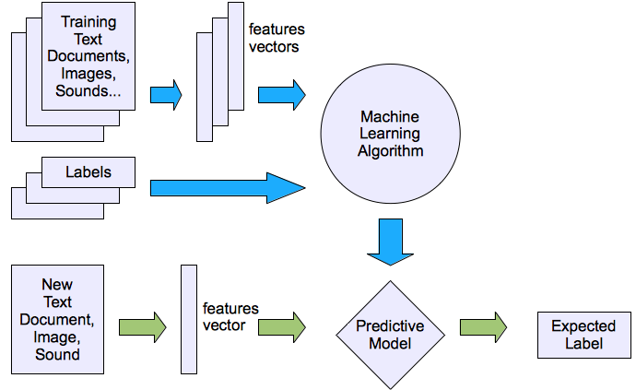
Supervised learning
Image Source: Yi-Fan Chang, An Overview of Machine Learning

Slide 33
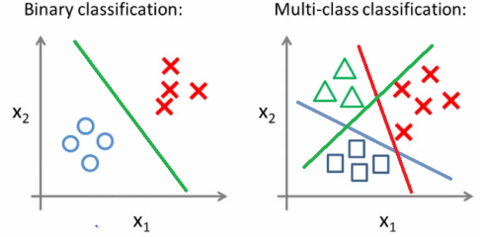
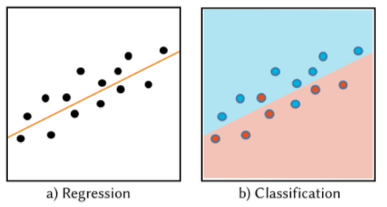

Classification and Regression
$x→f(x)→y∈\left\{−1, 1\right\}$; Binary Classification
$x→f(x)→y∈ℝ$ ; Regression
Image Source: https://utkuufuk.github.io/2018/06/03/one-vs-all-classification/
https://www.edvancer.in/foundations-of-data-science-made-simple-part-2/

Slide 34
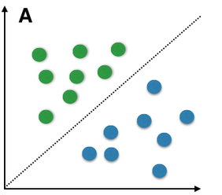
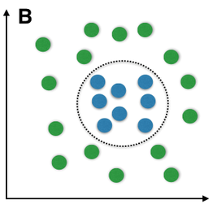
Linear and Non Linear Classification
Linear Classification
Non-Linear Classification
Find a straight line to separate (classify)
green from blue
There is no way that a straight line can be drawn to
discriminate the two classes
Examples of linear classifier are:
Linear Discriminant Classifier, Naive Bayes,
Logistic Regression, Perceptron,
SVM (with linear kernel)
Examples of non-linear classifiers are:
Quadratic Discriminant Classifier, Multi-layer Perceptron (most deep networks), Decision Trees, Random Forest, K-Nearest Neighbour

Slide 35



The Classification framework
Apply a prediction function to a feature representation of the image to get the desired output:
f( ) = “apple”
f( ) = “tomato”
f( ) = “cow”
Slide credit: L. Lazebnik

Slide 36
The Classification framework
y = f(x)
Training: given a training set of labeled examples {(x₁,y₁), …, (x_{N},y_{N})}, estimate the prediction function f by minimizing the prediction error on the training set
Testing: apply f to a never before seen test example x and output the predicted value y = f(x)
output
prediction function
Image feature
Slide credit: L. Lazebnik

Slide 37
Applications of Supervised learning :
Pattern recognition
Face recognition: Pose, lighting, occlusion (glasses, beard), make-up, hair style
Character recognition: Different handwriting styles.
Speech recognition: Temporal dependency.
Use of a dictionary or the syntax of the language.
Sensor fusion: Combine multiple modalities; eg, visual (lip image) and acoustic for speech
Medical diagnosis: From symptoms to illnesses
Web Advertising: Predict if a user clicks on an ad on the Internet.

Slide 38
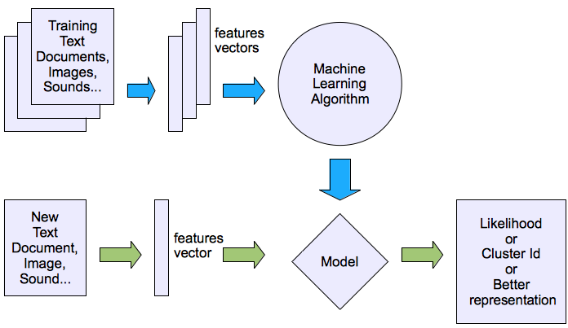
Unsupervised learning
Image Source: Yi-Fan Chang, An Overview of Machine Learning

Slide 39
Applications of unsupervised learning:
Clustering: Grouping similar instances
Other applications: Summarization, Association Analysis
Example applications:
Customer segmentation in CRM
Image compression: Color quantization
Bioinformatics: Learning motifs

Slide 40
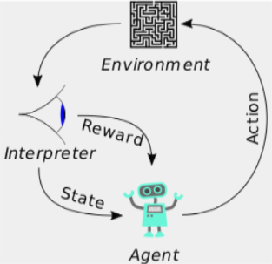
Reinforcement Learning
A computer program interacts with a dynamic environment in which it must perform a certain goal. The program is provided feedback in terms of rewards and punishments as it navigates its problem space.
Policies: what actions should an agent take in a particular situation
Utility estimation: how good is a state (→used by policy)
No supervised output but delayed reward
Credit assignment problem (what was responsible for the outcome)
Applications:
Game playing
Robot in a maze
Multiple agents, partial observability, ...

Slide 41
Machine Learning Applications
Recognizing Patterns:
Facial identities or facial expressions
Handwritten or spoken words
Medical images
Generating Patterns:
Generating images or motion sequences
Recognizing Anomalies:
Unusual sequences of credit card transactions
Unusual patterns of sensor readings in a nuclear power plant or unusual sound in your car engine.
Prediction:
Future stock prices or currency exchange rates

Slide 42
Some web-based examples of machine learning
The web contains a lot of data. Tasks with very big datasets often use machine learning
especially if the data is noisy or non-stationary.
Spam filtering, fraud detection:
The enemy adapts so we must adapt too.
Recommendation systems:
Lots of noisy data. Million dollar prize!
Information retrieval:
Find documents or images with similar content.
Replying Short Emails Automatically
Data Visualization:
Display a huge database in a revealing way.

Slide 43
Applications of ML in Healthcare
Predictive Analytics
Assistive Robots (Spline Surgery)
Virtual Nursing Assistance (Assist the Patients)
Administrative Tasks
Lots of aids will be provided
Medical outcomes analysis
Cancer Identification
Scarcity of Nurses and Doctors can be eliminated
Predicting Cardiovascular risks
Predicting medical events
Medical diagnosis: From symptoms to illnesses

Slide 44
Applications of ML in Agriculture
Crop is ready or not and Quality of Crop
Segregation of crop based on quality (Crop Classification)
Predicting Crop Yield
Irrigations Schedule
Disease detection from the plants
Predicting the approximate weight of the crop
Health monitoring of the crop
Analyzing and Predicting the Profit from the crop

Slide 45
Other Applications of ML
Summarization of movie
Recognizing the mood of the person
Sentiment Analysis
Image Editing
Auto Caption Generation
Object Recognition and Classification
Scene and Context categorization of the outdoor image
Generating Handwriting from notes
Automatic colorization of image and movie

Slide 46
Other Applications of ML
Find all possible objects from an image
Multi digit recognition from an image
Labeling an aerial image
Signature Verification
Target Recognition
Traffic Monitoring
Facial Expression Recognition
Identification of fake news
Tagging people automatically

Slide 47
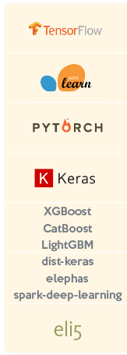
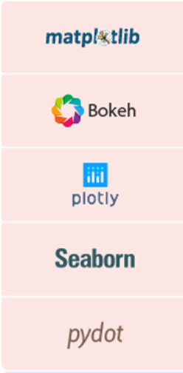
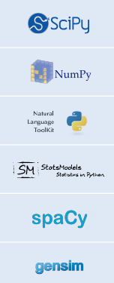
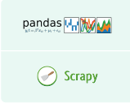

Python Libraries for Machine Learning
Machine Learning | Visualization | Mathematics for Data Science | Data Manipulation & Analysis

Slide 48
Growth of Machine Learning – Current State
Machine learning is preferred approach to
Speech recognition, Natural language processing
Computer vision
Medical outcomes analysis
Robot control
Computational biology
This trend is accelerating – Deep Learning…
Improved machine learning algorithms
Improved data capture, networking, faster computers
Software too complex to write by hand
New sensors / IO devices
Demand for self-customization to user, environment

Slide 49
Research issues in Machine Learning
Handling large amount of data
High dimensionality
Training Time is more (Hours or Days)
Labeling of data or labeling of Images & Videos
Processing Performance for Training and Testing (Validating)
Accessing Reference Model – Transfer Learning
Optimizing Hyper parameters
Rapid and Optimized deployment
Curse of Modularity
Class Imbalance
Feature Engineering
Variance and Bias
Feature Extraction
Applications specific training – Less Generalization

Slide 50
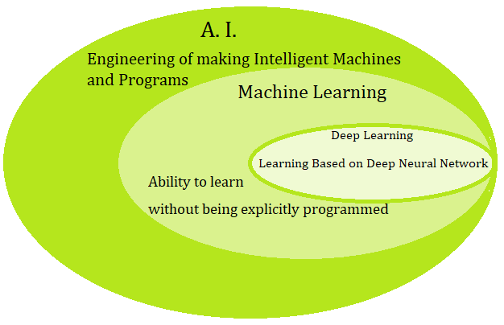
Deep Learning

Slide 51
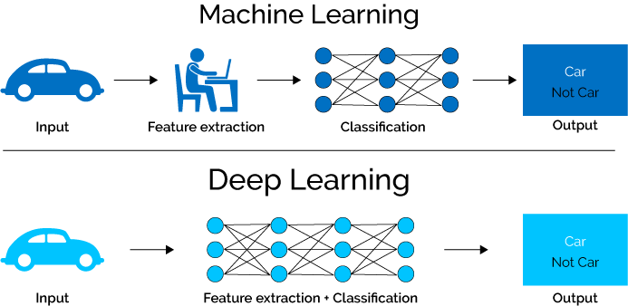
Difference between ML and DL
Image Source: https://www.xenonstack.com/blog/log-analytics-with-deep-learning-and-machine-learning

Slide 52
Where is Machine Learning and Deep Learning being applied right now?
Computer Vision: for applications like vehicle number plate identification and facial recognition.
Information Retrieval: for applications like search engines, both text search, and image search.
Marketing: for applications like automated email marketing, target identification
Medical Diagnosis: for applications like cancer identification, anomaly detection
Natural Language Processing: for applications like sentiment analysis, photo tagging
Online Advertising

Slide 53
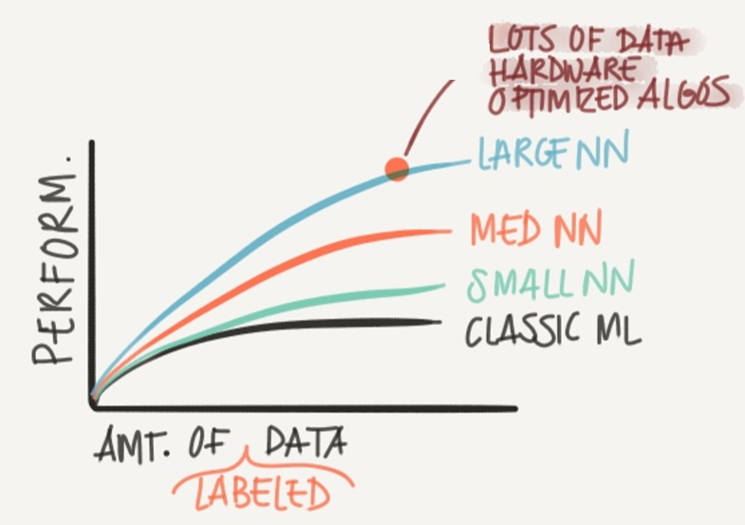
Why Deep Learning taking off?
Lots of Data – Structured and Unstructured
Computation Power – GPU
Efficient Algorithms

Slide 54
Types of Deep Networks
There are different deep networks like
Convolutional Neural Network (CNN),
Recurrent Neural Network (RNN),
Deep Belief Network (DBN),
Recursive Neural Tensor Network (RNTN),
Long and Short Term Memory (LSTM)
Restricted Boltzman Machine (RBM).
Auto Encoder

Slide 55
Types of Deep Network
Applications | Deep Network
Text Processing | RNN, RNTN
Image Recognition | CNN, DBN
Object Recognition | CNN, RNTN
Speech Recognition | RNN
Time Series Analysis | RNN
Unlabeled data-pattern recognition | RBM

Slide 56
Comparison of Deep Learning Models
Model | CNN | RNN | LSTM | RBM | DBN | Auto-encoder
Type | Discriminative | Discriminative | Discriminative | Generative | Generative | Generative
Purpose | Classification | Prediction | Prediction | Unsupervised Feature Learning | Unsupervised Feature Learning | Dimensionality Reduction
Suitable for | Processing two-dimensional data | Processing sequence data | Processing long sequence data | Learning distribution of data | Creating a probabilistic recommendation of data | Creating a compact representation of data
Example | Images/ Videos | Language Models and speech | Language Models and speech | Generate samples from learned hidden representation | Trained layer used as feature detector | PCA-like tasks

Slide 57



















Deep Learning Library
Deep Learning Cloud Services

Slide 58
Challenges with Deep Learning
Handling a large amount of data
Avoid over fitting problem
Hyper parameters Optimization
Requires high-performance hardware
Rapid and Optimized deployment

Slide 59
Research issues in Deep Learning
Huge amount of data
Overfitting in Neural Networks
Hyperparameter Optimization
High-performance Hardware Requirement
Essentially – It is a Blackbox
Lack of Flexibility, Scalability and Multitasking
Generative Models – learn and then generate new images
Video Processing and Analytics
Deep Learning in Embedded System
Generalization of algorithms – (Partial Solution: Transfer Learning)
CPU to GPU Data Transfer Time

Slide 60
Conclusion
AI and ML will completely change the way of working through decision making and decision support system.
AI and ML hold tremendous promise to expand access to quality services by freeing up human attention to focus on higher value problem solving while ensuring a uniformly high quality of performance.
Lot of research work is required to give concrete AI based system

Slide 61
Future Trends
Deep learning is surprising us each and every day, and will continue to do so in the near future. This is because Deep Learning is proving to be one of the best technique to be discovered with state-of-the-art performances.
Research is continuous in Machine Learning and Deep Learning. But unlike in previous years, where research was limited to academia, research in Machine Learning and Deep Learning is exploding in both industry and academia.

Slide 62
Future Trends
First of all, seeing the increasing trend of using data science and machine learning in the industry, it will become increasing important for each company who wants to survive to inculcate Machine Learning in their business. Also, each and every individual would be expected to know the basics terminologies
Deep learning is surprising us each and every day, and will continue to do so in the near future. This is because Deep Learning is proving to be one of the best technique to be discovered with state-of-the-art performances.

Slide 63
Reading Materials
Text Book: https://www.deeplearningbook.org/
https://www.coursera.org/learn/machine-learning
deeplearning.ai
http://cs231n.stanford.edu/
https://github.com/floodsung/Deep-Learning-Papers-Reading-Roadmap
https://github.com/terryum/awesome-deep-learning-papers

Slide 64
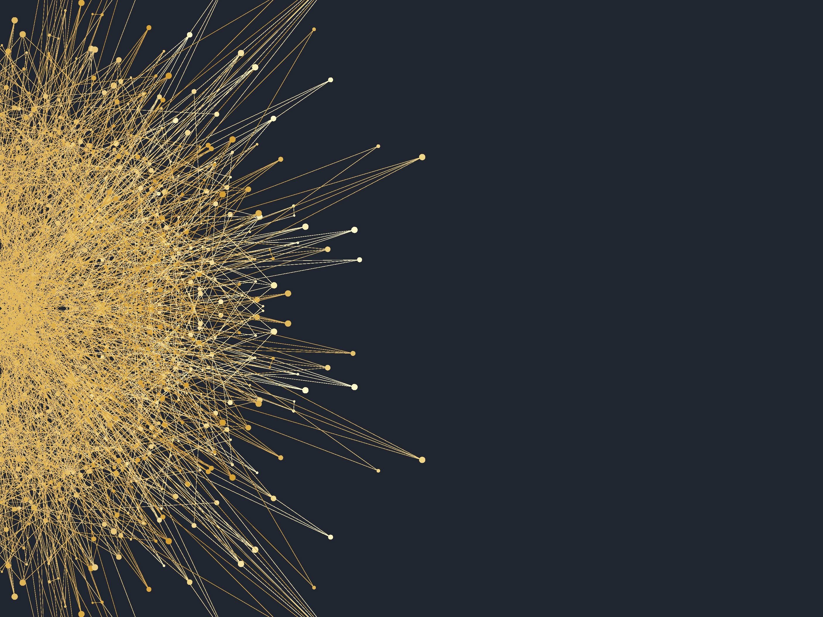
Thank you!
Any Question..?

